Slide 1


Student Details
Name: Neeharika Vasadi
Email ID: neeharika_vasadi@srmap.edu.in
College: SRM University
College State: Andhra Pradesh
Internship Domain: Artificial Intelligence and Machine Learning
Period of the internship: 3-06-24 to 31-07-24

Slide 2
Problem Statement: Employee Burnout Prediction
Employee burnout is extreme stress-related physical, emotional, and mental exhaustion that can negatively impact health and job performance. This project aims to develop a regression model to predict burnout by analyzing workload, mental fatigue, job role, and work-life balance factors. Identifying at-risk employees will help organizations take preventive measures to improve employee well-being and productivity.

Slide 3
AGENDA
Project Overview
Who Are The End User?
Your Solution and its Value Proposition
How did you customize the project and make it your own
Modelling
Results
Links

Slide 4
PROJECT OVERVIEW
Objective: Develop a machine learning model to predict employee burnout using factors such as mental fatigue score and burnout rate.
Motivation: Employee burnout, characterized by prolonged stress and exhaustion, impacts health and productivity. Early prediction and intervention are vital in maintaining employee well-being.

Slide 5
PROJECT OVERVIEW
Methodology:
Data Collection: Gather data on workload, mental exhaustion, and work-life balance.
Model Development: Use regression techniques to build a predictive model.
Evaluation: Assess model performance with metrics like MSE and R-squared.
Implementation: Create a user-friendly system for burnout risk prediction.
Feedback and Improvement: Refine the model based on user feedback.
Expected Outcome: A tool to help organizations identify and address burnout risk, enhancing employee well-being and productivity.

Slide 6
WHO ARE THE END USERS?
The end users of a project vary based on the nature of the project. They are the individuals or groups who directly interact with or benefit from the project's outputs or outcomes. Examples include:
HR Professionals: Manage employee well-being and implement burnout prevention strategies.
Management Teams: Make decisions to improve workplace conditions and reduce burnout.
Organizational Leaders: Drive initiatives to enhance employee satisfaction and align goals.
Data Analysts: Analyze data on burnout to provide actionable insights and reports.

Slide 7
Solution: The method involves developing a predictive model to assess employee burnout based on various factors like job characteristics, mental health indicators, and demographics. Using advanced machine learning techniques, the model will analyze the data and identify key predictors of burnout.
Value Propositions: These are the unique benefits or advantages the solution offers its users. They can include:
Cost savings
Improved efficiency
Enhanced performance
Better user experience
Environmental sustainability
Increased productivity through better task organization
YOUR SOLUTION AND ITS VALUE PROPOSITION

Slide 8
How did you customize the project and make it your own
Understand Requirements: Define the project's goals and gather input from stakeholders.
Design Solutions: Create prototypes and plans that align with project goals.
Implement Customization: Integrate tailored features or designs into the project.
Test and Iterate: Ensure quality and make adjustments based on feedback.
Deploy and Gather Feedback: Launch the project, collect user feedback, and make improvements.
Document and Maintain: Record customization details and set up a maintenance plan for updates.

Slide 9
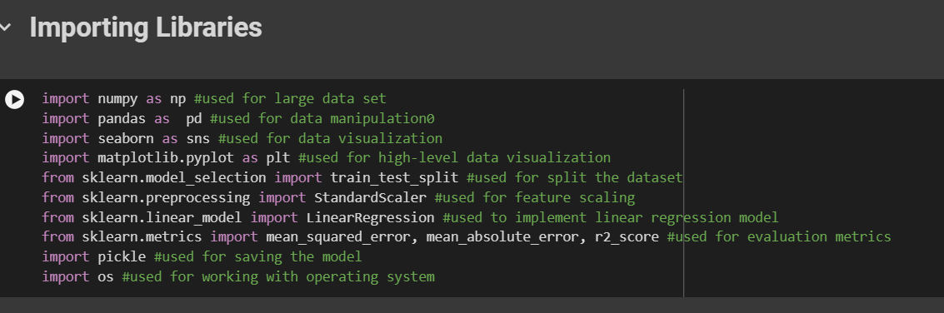
Modelling
Importing Libraries

Slide 10
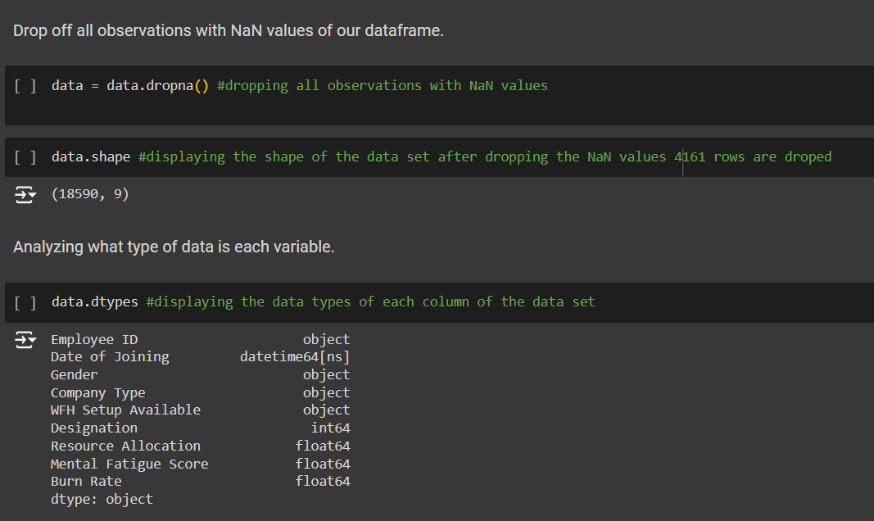
Handling missing values

Slide 11
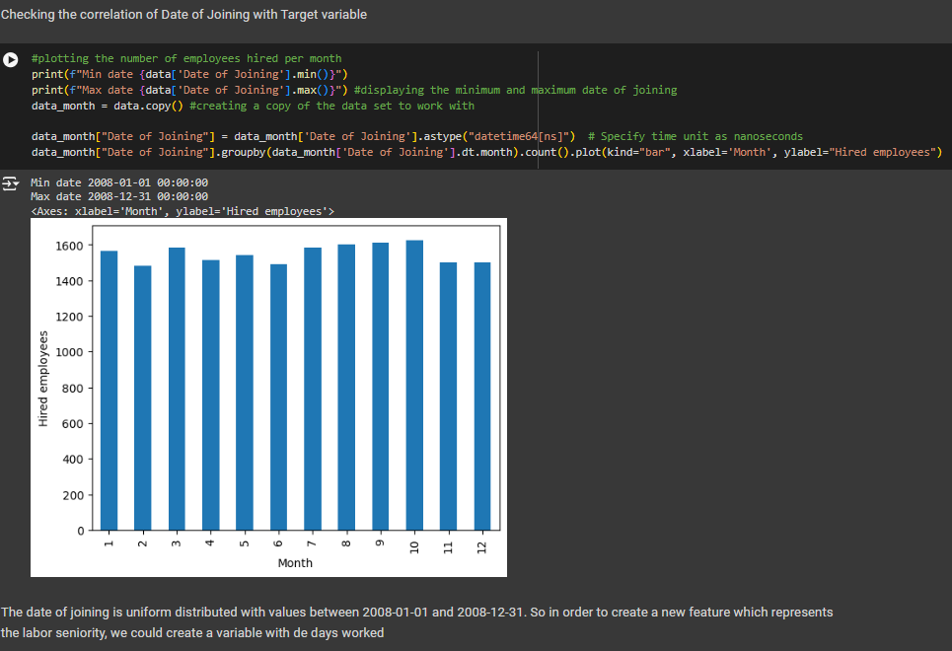
Analyzing categorical data
The Employee ID column was eliminated since it doesn't influence the burn rate. To evaluate the effect of the Date of Joining column, it was transformed into a DateTime format, and each employee's employment duration in days was calculated.

Slide 12
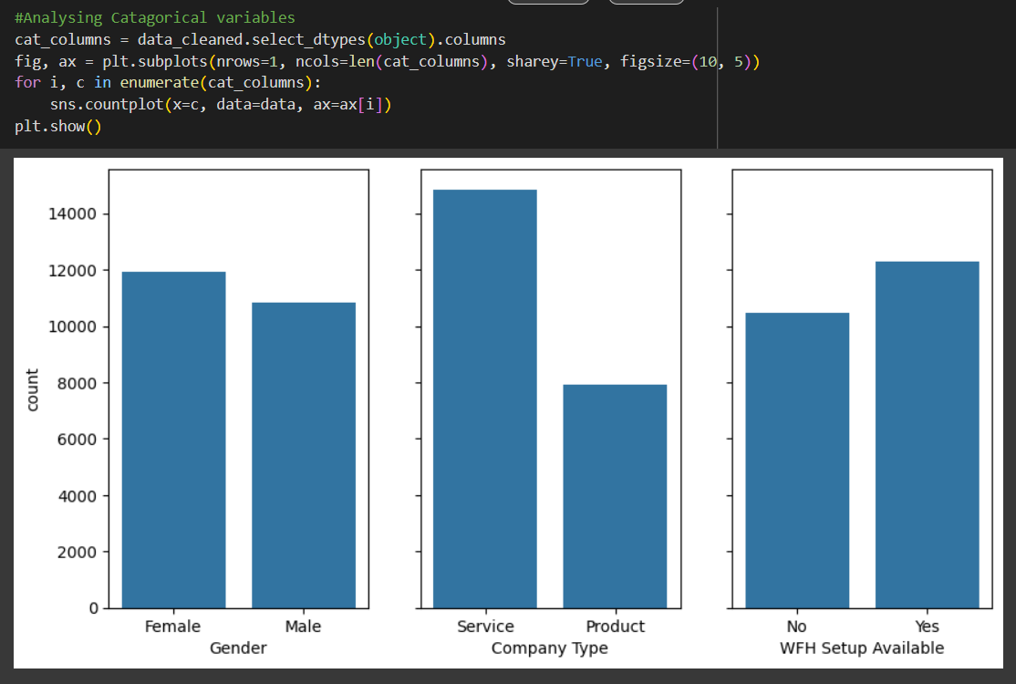
Analyzing categorical data
We then analyzed the remaining categorical columns and proceeded further with our analysis. Our conclusion revealed that the data in each column is normally distributed, except for the Company Type column.

Slide 13
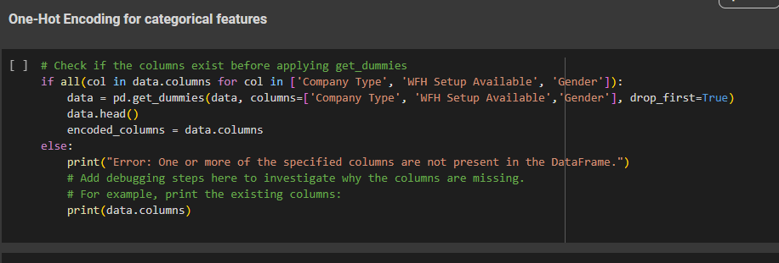
One-Hot Encoding
We utilized one-hot encoding to transform categorical data into a numerical format appropriate for our predictive model. This method entails encoding the categorical values with dummy numerical values, allowing the machine learning algorithms to handle this information efficiently.

Slide 14
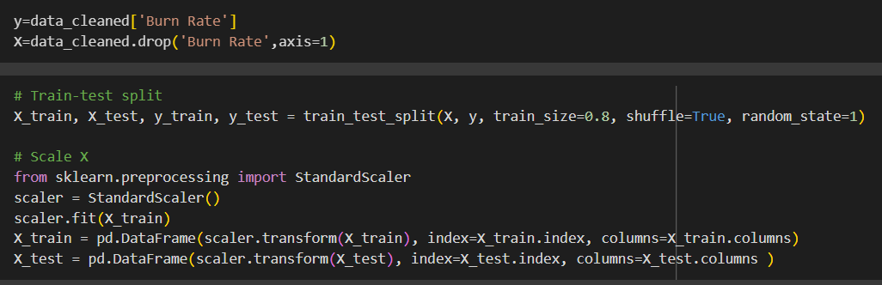
Data spitting and scaling
We divided the dataset into training and testing sets with a 7:3 ratio to train the linear regression model. To scale the features, we used a standard scaler to standardize the data, ensuring each feature has a mean of 0 and a standard deviation of 1.

Slide 15
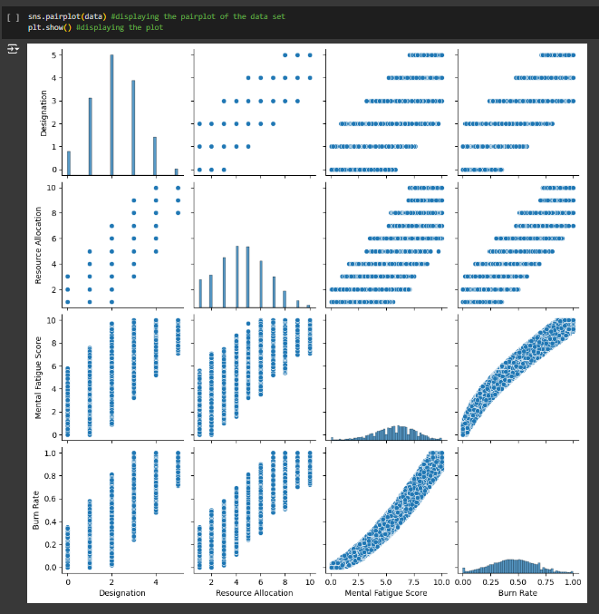
Results
Using this function, we established the correlation between variables. The seaborn library's pair plot function produces a matrix of scatter plots. We need to focus mainly on the last row, which has the burn rate on the y-axis, as burn rate is the target variable. This row helps us understand how each feature correlates with the burn rate.

Slide 16
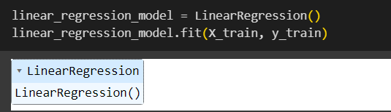
Results
Linear Regression Model
We trained the linear regression model using the training dataset. The model now includes five independent variables: Designation, Resource Allocation, Mental Fatigue Score (MFS), Company Type, and Work From Home (WFH) setup, with the burn rate as the dependent variable to be predicted. By examining these features, the model aims to pinpoint the key factors contributing to employee burnout and make precise predictions.

Slide 17
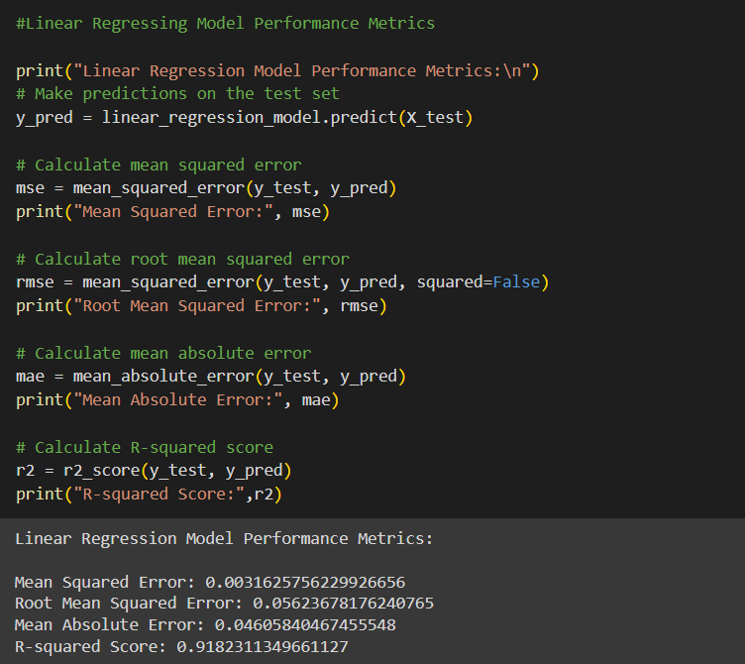
Results
Calculating the Metrics
According to the evaluation metrics, the Linear Regression model is the most effective for predicting burnout analysis. It demonstrates the lowest mean squared error, root mean squared error, and mean absolute error, signifying higher accuracy and precision in its predictions. Furthermore, it has the highest R-squared score, indicating a good fit to the data and explaining a larger proportion of the variance in the target variable. Therefore, we have decided to deploy this model.

Slide 18
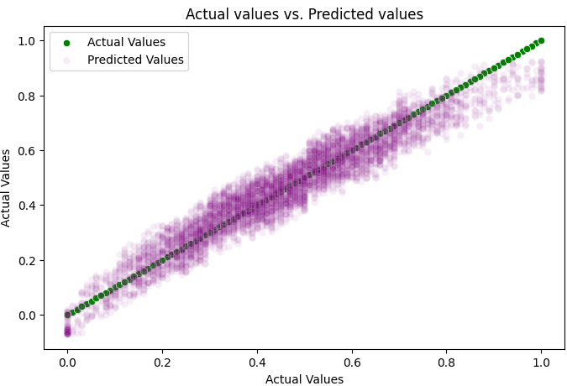
Results
The plot illustrates the actual versus predicted values for the burn rate, with the red dotted line representing the regression line fitted by the model. This visualization aids in assessing the model's accuracy by comparing the predicted burn rates to the actual values. Ideally, the predicted values should closely match the actual values, and the green dotted line should closely follow the trend of the data points.

Slide 19
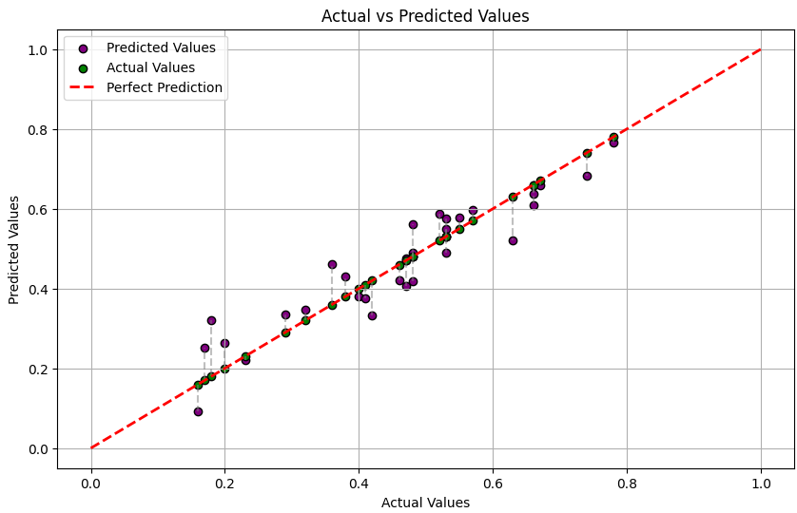
Results
We selected 30 random samples from the dataset and plotted their actual versus predicted values on the best fit line. This visualization demonstrates how closely the model's predictions align with the actual burn rate values for these samples, offering insights into the model's accuracy and performance.

Slide 20
Links
CO-Lab link: https://colab.research.google.com/drive/1ugdKgoCBU-_iWbRA6VUrKJBz62YHJIGv?usp=sharing
Data set from Kaggle: https://www.kaggle.com/datasets/blurredmachine/are-your-employees-burning-out
Git-hub Link: https://github.com/Neeharikavasadi/Edunet-Internship.git
E-mail ID: neeharika_vasadi@srmap.edu.in

Slide 21
THANK YOU!

